Slide 1
GEOG0113: Geography in the field
Introduction to Statistics
GETTING YOU STARTED with the learning materials
Dr Anwar Musah (a.musah@ucl.ac.uk)
Lecturer in Social and Geographic Data Science
UCL Geography
1
Notes:
Hello everyone,
My name is Anwar Musah. Welcome to GIF1 Data analysis.
The purpose of this video – is to give you folks a heads-up on how to access the material and get started for the self-learning of RStudio and Statistics to prepare for the workshops and formative assignment. But more importantly prepare for what’s ahead in term 2 GIF2. As it is here, where you will learn the basic coding ett., basics to data managing, and implement descriptive analysis and probabilities, which carries forward to next term.

Slide 2
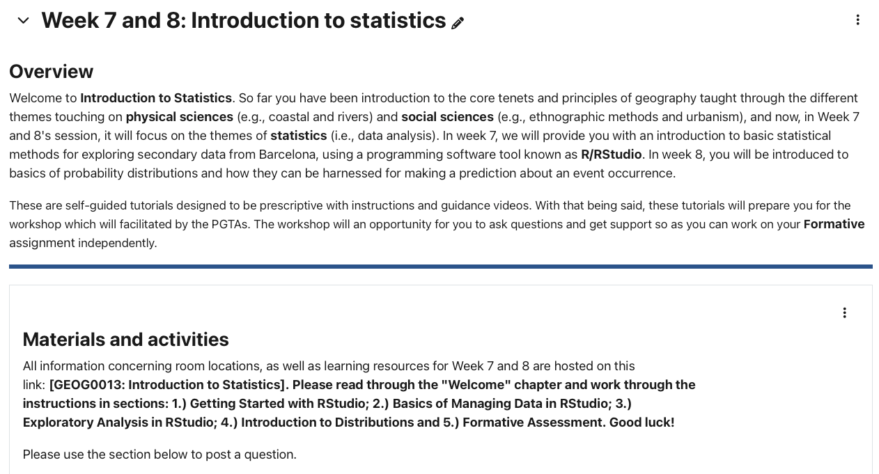
How access the learning materials on Moodle?
URL: https://uclpg-msc-sgds.github.io/GEOG0013/
Please click on the link “[GEOG0013: Introduction to Statistics]”
2

Slide 3
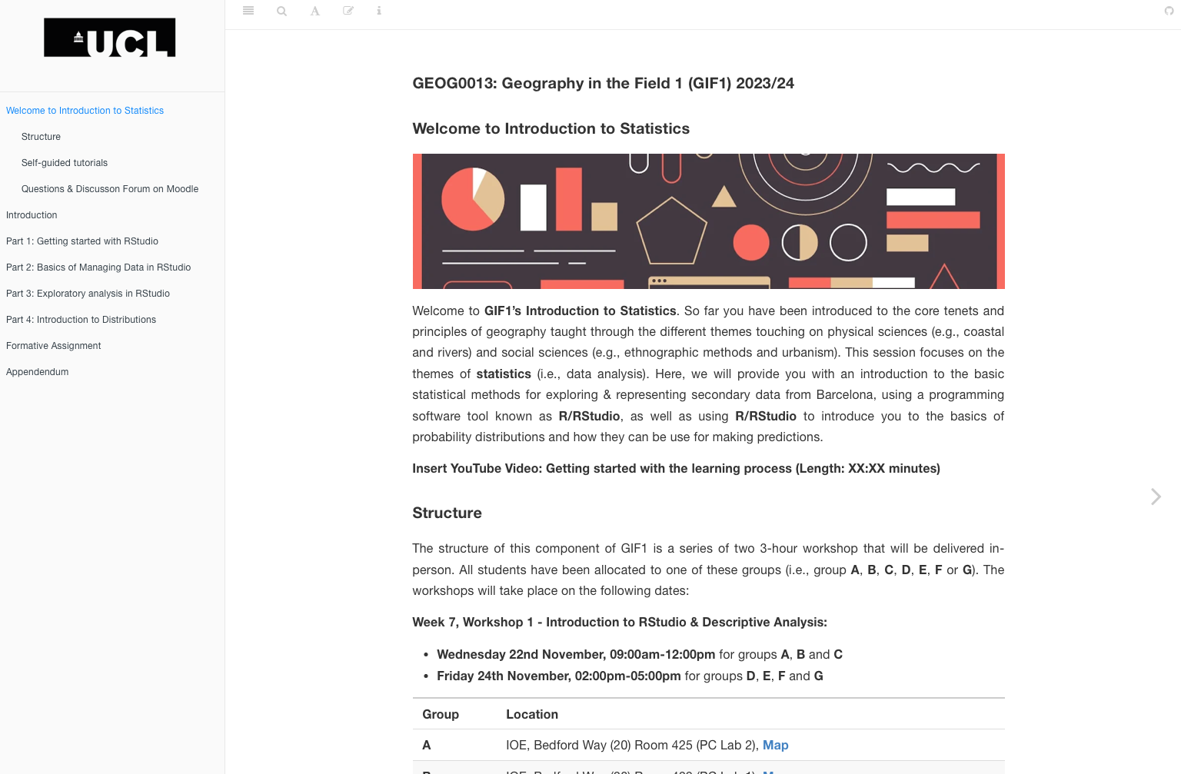
Welcome Page for GEOG0013: Introduction to Statistics
3

Slide 4

Navigating through learning materials? [1]
The welcome page contains all the necessary information needed to get started, as well as details for groups & room locations for the workshops.
4

Slide 5
Navigating through learning materials? [2]
These chapters are the tutorials for learning R programming and statistics. They contain all the necessary instructions and guidance videos.
5

Slide 6
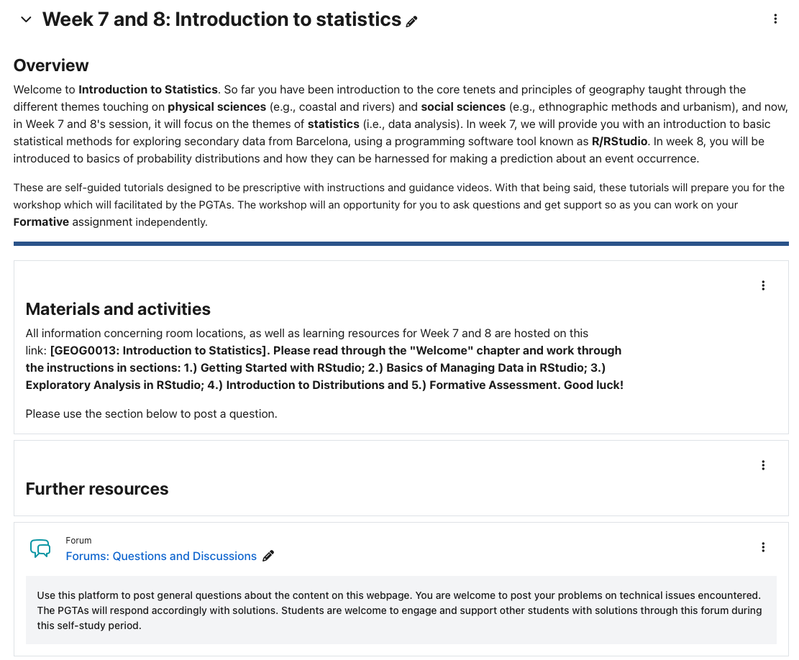
How to post questions and key contacts
Use this section in MOODLE to post question related to RStudio issues or statistics problem. Myself, or one of the PGTAs will try to responds as soon as possible!
Contact us for critical problem only. Do not post any R-related questions directly to us. Please use the forum in Moodle.
Dr. Anwar Musah: a.musah@ucl.ac.uk
Professor Helen Bennion: h.bennion@ucl.ac.uk
Geography Office: geog.office@ucl.ac.uk
6

Slide 7
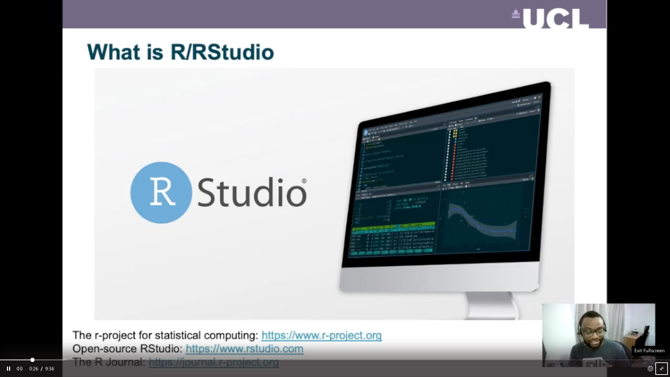
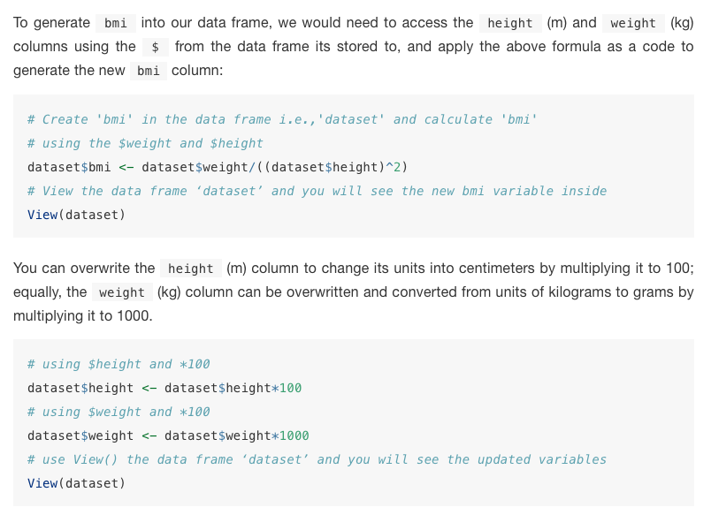
Format and learning flow [1]
There will always be a video to explain the necessary theory of the statistical method, as well as an explanation of the code
7

Slide 8
Format and learning flow [2]
There will always be a text to explain the necessary what the code is also doing, and steps for coding – so here, you will have to read through the text.
8

Slide 9
Format and learning flow [3]
There will always be code chunks for you to replicate and study in your own RStudio.
The code chunks will be annotated with a # (hash tag) with a comment to give context. So, this is not actual code
The real code is the code chuck with no # (hash tag) at the beginning.
# Comment
Actual code
9

Slide 10
Any questions?
Use this section in MOODLE to post question related to RStudio issues or statistics problem. Myself, or one of the PGTAs will try to responds as soon as possible!
10

